Slide 1



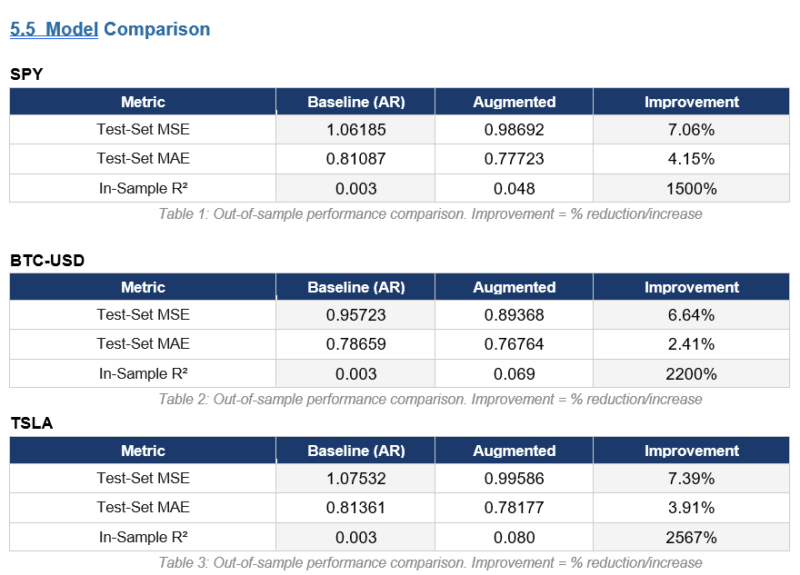
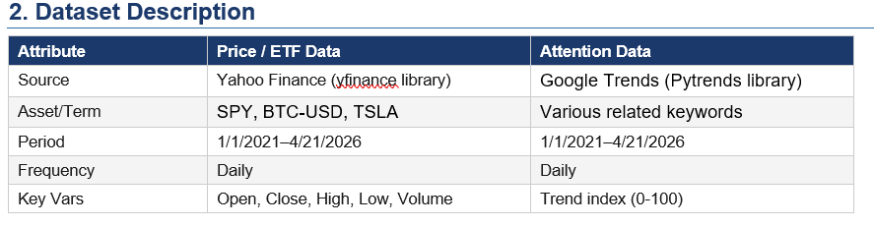
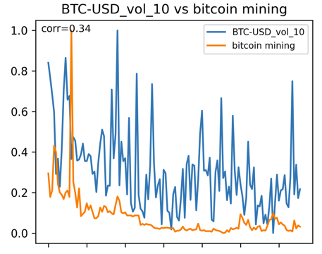
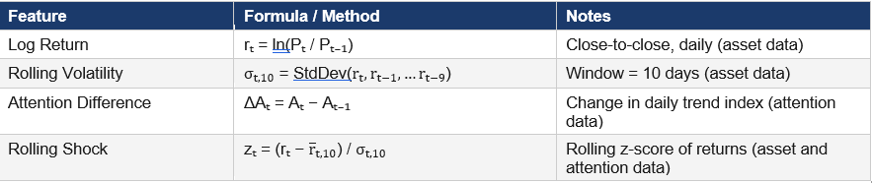
Attention Metrics and Asset Price Dynamics in Financial Time Series
The goal of this analysis is to test whether investor attention, proxied by Google Trends, can improve model performance when predicting asset shocks and returns.
The augmented model adds contemporaneous and lagged attention variables A_{t}, the trend index, ΔAₜ, the change in trend index, and zₜᵃ, the normalized trend index shock. The top 5 metrics were used together in the final model for each asset.
The augmented model performed 2-7% better out-of-sample across all three assets. This suggests that attention metrics may be viable as a source of information when predicting asset pricing behavior.
Figure 1
Figure 1 shows one of the plots with the highest Pearson correlation coefficients at R=0.34. Visually, the strongest attention metrics appeared to have weak to medium correlations to actual asset data.

